Slide 1
ASP.NET CORE – Web API

Slide 2
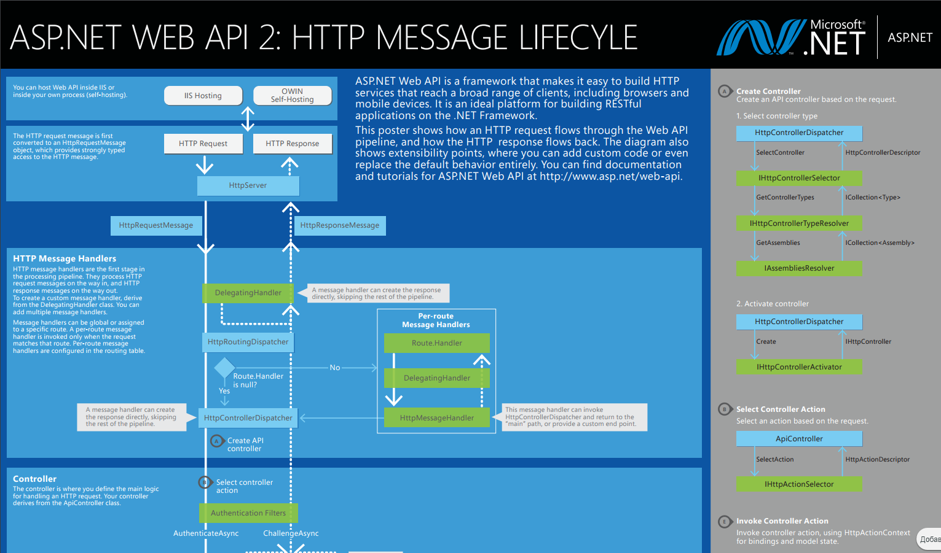

Web API fundamentals

Slide 3
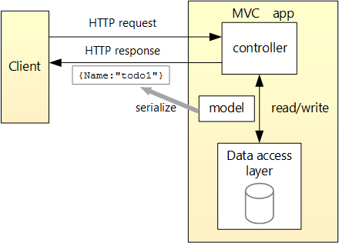
Web API architecture

Slide 4
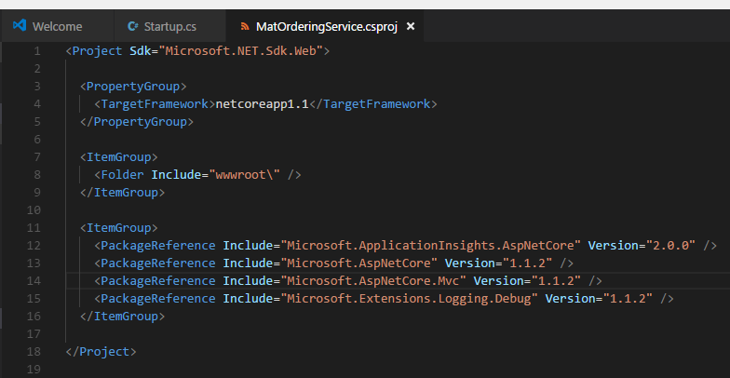
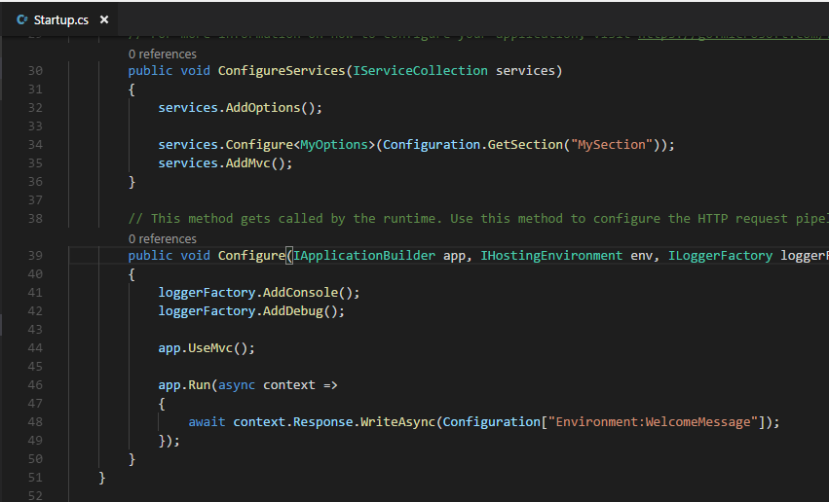
Setup the project for Web API

Slide 5
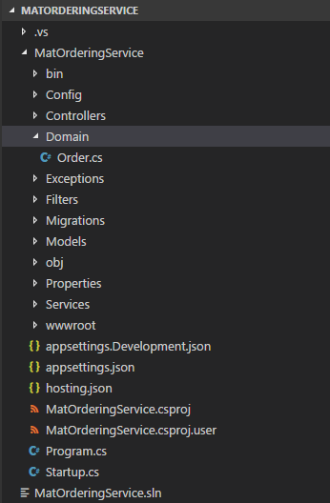
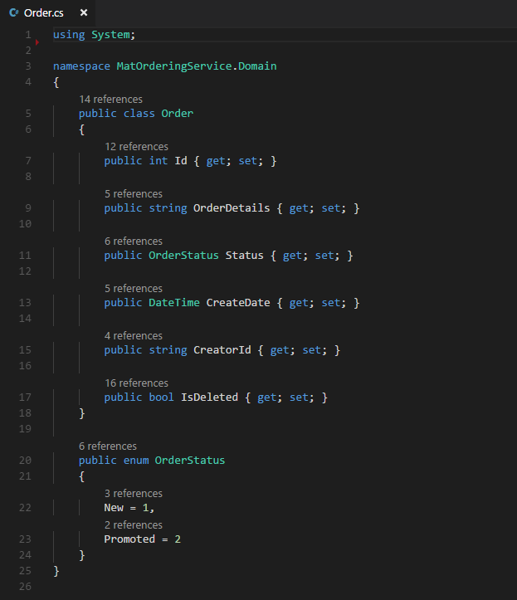
Add domain models

Slide 6
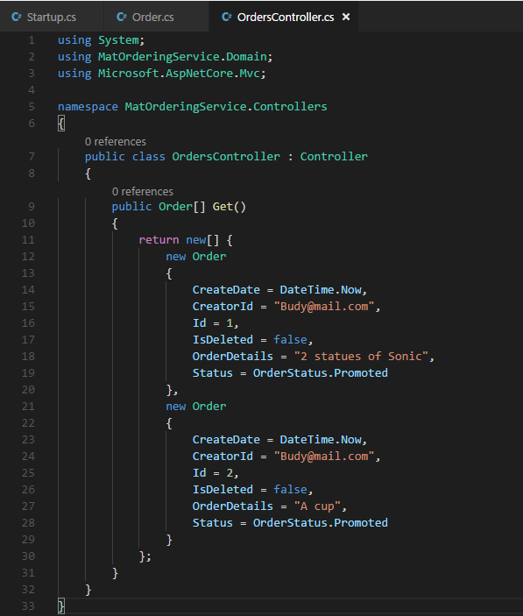
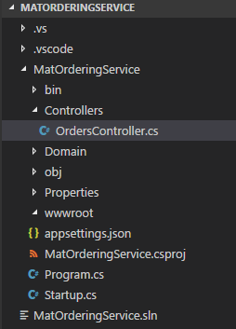
Add Orders Controller

Slide 7
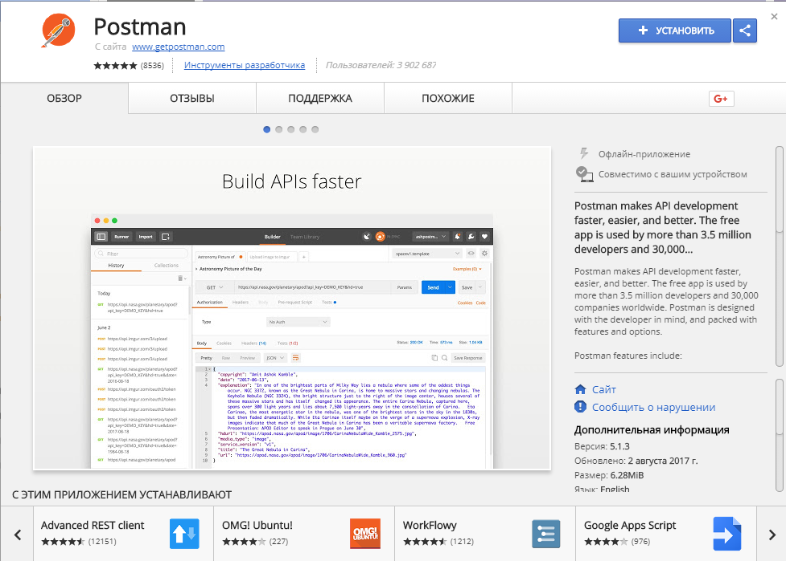
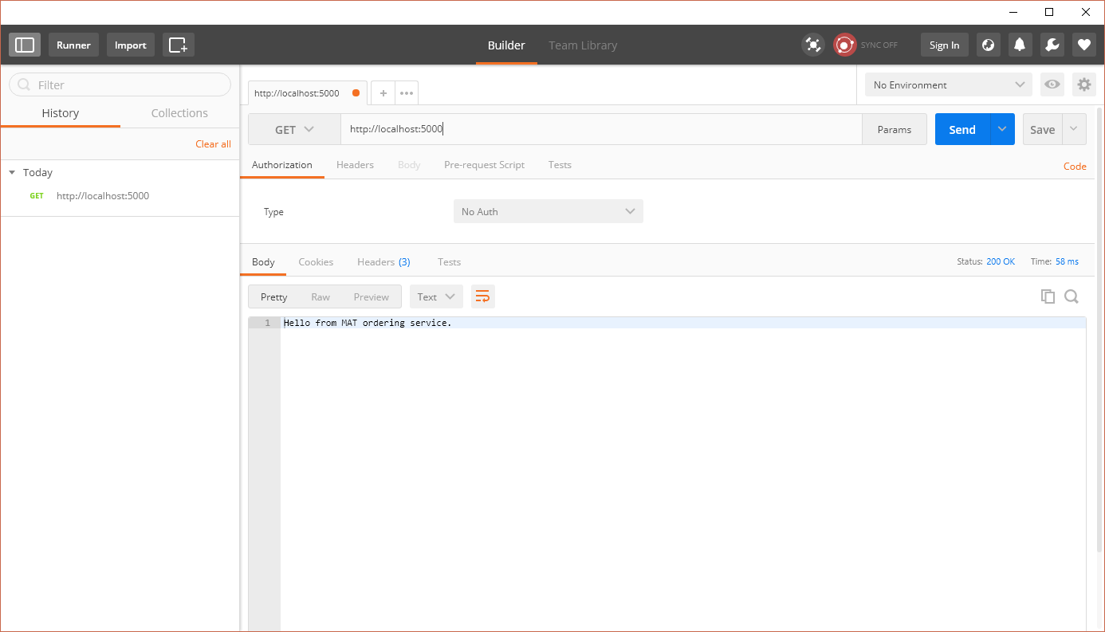
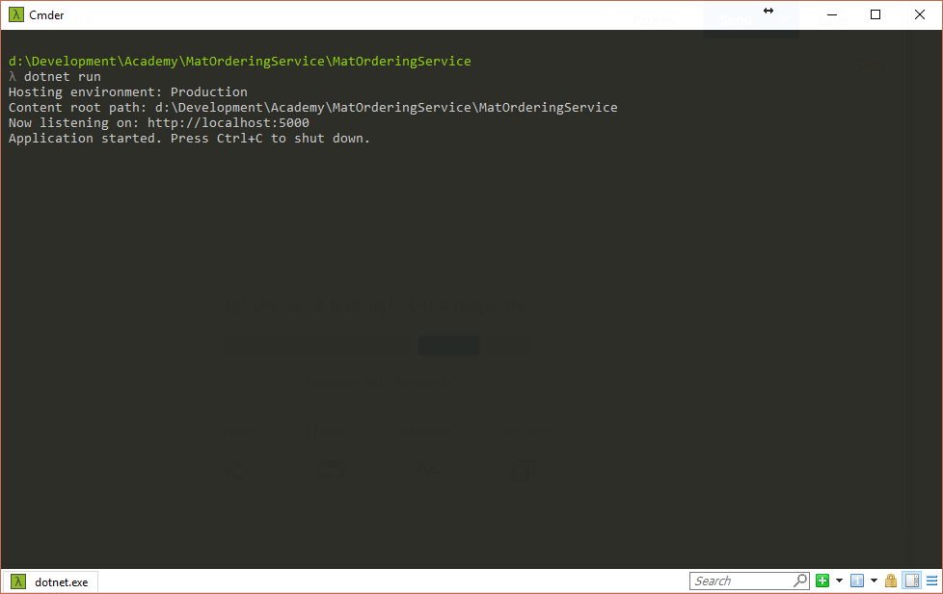
Setup Postman

Slide 8
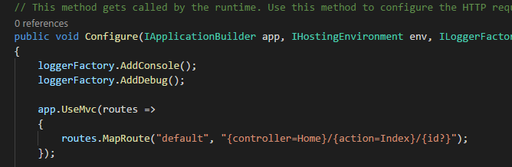
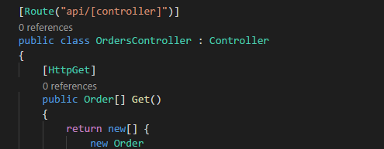
Routing
- configure MVC middleware with routing;
- attribute routing;

Slide 9
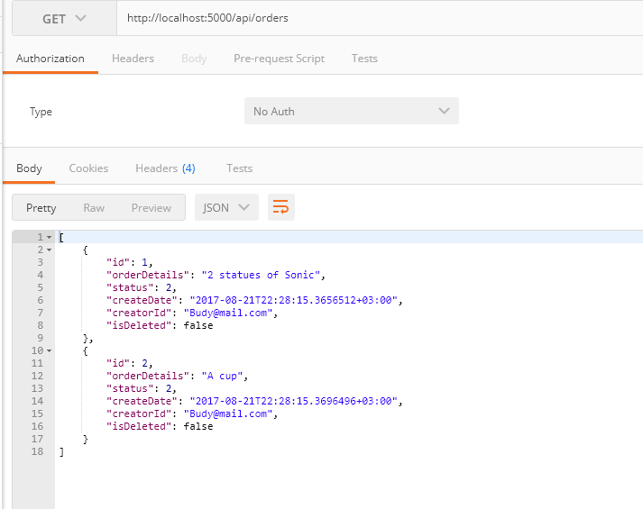
Getting Orders

Slide 10
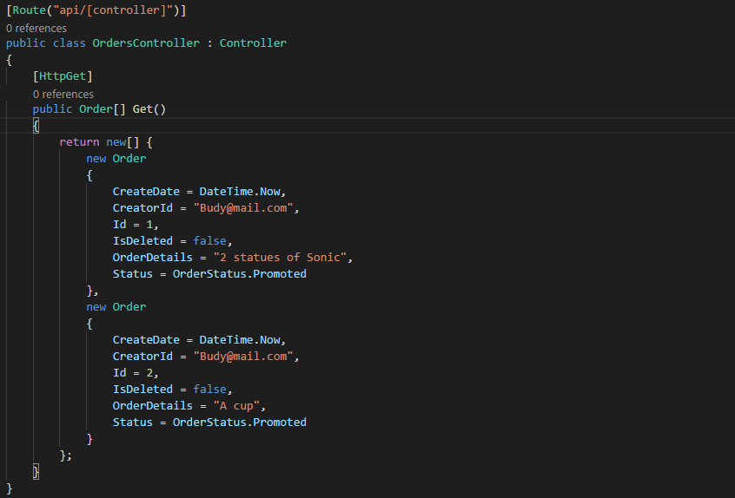
What’s next?

Slide 11
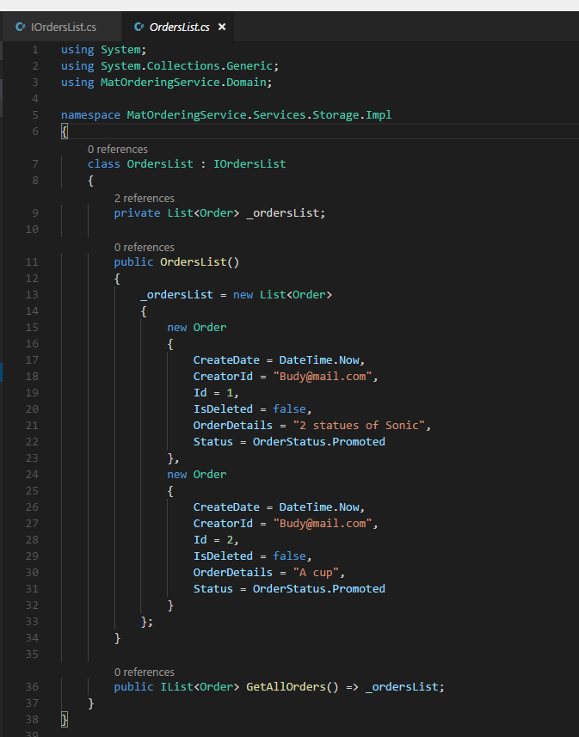
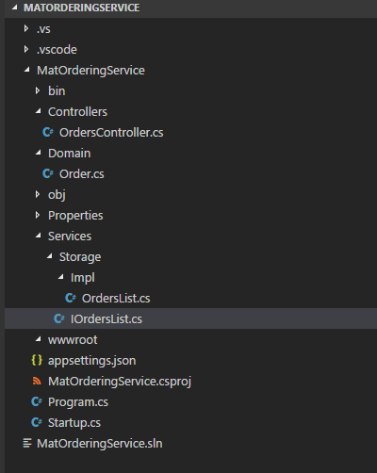
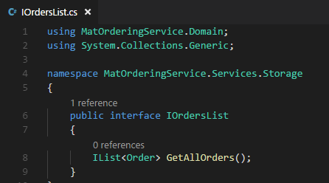
Orders List Service

Slide 12
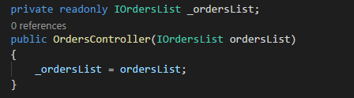
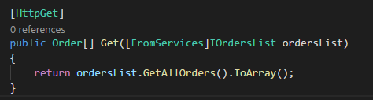
Dependency injection into controllers
Constructor Injection
Action Injection with FromServices

Slide 13
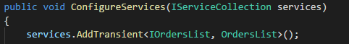
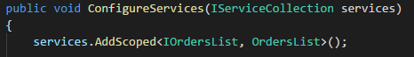
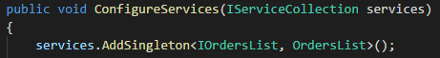
Registering Your Services
ASP.NET services can be configured with the following lifetimes:
Transient lifetime services are created each time they are requested.
Scoped lifetime services are created once per request.
Singleton lifetime services are created the first time they are requested and then every subsequent request will use the same instance.

Slide 14
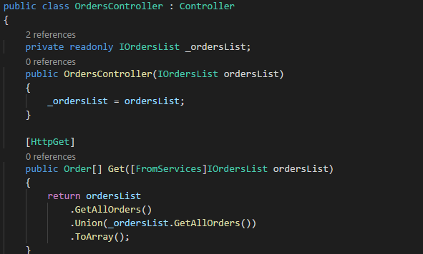
Checking Lifetimes

Slide 15
Links
https://www.microsoft.com/net/download/thank-you/aspnet-ebook
https://docs.microsoft.com/en-us/aspnet/web-api/overview/getting-started-with-aspnet-web-api/tutorial-your-first-web-api
https://metanit.com/sharp/aspnet5/23.1.php
https://habrahabr.ru/post/181988/

